Slide 1

ABC Insurance -
Snowflake Data Engineering Project
Team Members
- Suhani Gahukar
- Khushi Dekate
- Mayuri Motwani

Slide 2
Project Objective
Establish a trusted and consistent view of policy and claims data.
Improve data quality, completeness, and validation across insurance records.
Enable better decision-making for underwriting, claims, and distribution teams.
Standardize business metrics for customer behavior and claim severity analysis.
Provide insight into operational gaps and growth opportunities.
Build a scalable Snowflake-based analytics platform for reporting and KPIs.

Slide 3
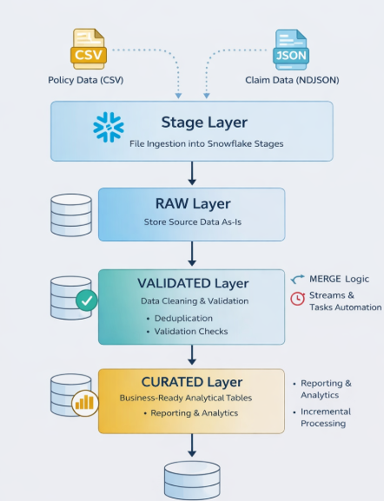
Architecture Overview
Stage Layer: Ingest policy and claim files into Snowflake internal stages.
RAW Layer: Store source data exactly as received without transformation.
VALIDATED Layer: Perform data cleaning, deduplication, and validation checks.
CURATED Layer: Create business-ready tables for reporting and analytics.
Implement incremental processing using MERGE logic.
Automate pipeline using Streams and Tasks for efficient data processing.

Slide 4
Data Sources & File Formats
Policy data received as CSV files (structured data).
Claim data received as NDJSON files (semi-structured data).
Master files contain the initial full dataset.
Incremental files contain newly added or updated records.
CSV data loaded into structured Snowflake tables.
JSON data stored using VARIANT data type for flexible schema handling.

Slide 5
RAW Layer Processing
Load policy CSV files into structured tables using COPY INTO command.
Load claims NDJSON files into tables using the VARIANT data type for semi-structured data.
Store data exactly as received from the source without any transformation.
Capture file metadata and load timestamps for auditing and tracking.
Maintain separate RAW tables for policies and claims data.
Enable traceability and recovery by preserving the original source data.

Slide 6
Semi-Structured Data Handling
Use VARIANT data type to store JSON claim data in Snowflake.
Handle NDJSON files where each record is stored as a JSON object.
Extract nested fields using dot notation (e.g., data:customer_id).
Support arrays and nested structures within JSON records.
Enable schema-on-read, allowing flexible structure for incoming data.
Convert required JSON fields into structured columns during validation stage.

Slide 7
VALIDATED Layer Processing
Perform data cleaning and transformation on RAW layer data.
Remove duplicate records using primary keys like policy number or claim ID.
Apply data quality checks such as null validation, date validation, and premium validation.
Extract structured fields from JSON VARIANT columns.
Standardize data formats (dates, text, phone numbers, etc.).
Ensure referential integrity between policies and claims tables.

Slide 8
INCREMENTAL Processing
Process new and updated records using incremental data files.
Implement MERGE logic to update existing records and insert new records.
Prevent duplicate data loading during repeated pipeline runs.
Ensure idempotent processing, allowing safe re-execution of pipelines.
Improve pipeline efficiency by avoiding full data reloads.

Slide 9
Security & Governance
Implement Dynamic Data Masking to protect sensitive fields like SSN and contact details.
Apply Row Access Policies to restrict access based on region or role.
Use RBAC (Role-Based Access Control) to manage user permissions.
Maintain audit logs and metadata tracking for monitoring data access.
Ensure data privacy and compliance with security policies.

Slide 10
Automation with Streams & Tasks
Use Streams to capture changes (inserts, updates, deletes) in tables.
Schedule Tasks to automatically process incremental data.
Enable continuous data pipeline execution without manual intervention.
Reduce processing time by handling only changed data.
Improve overall data pipeline efficiency and reliability.

Slide 11
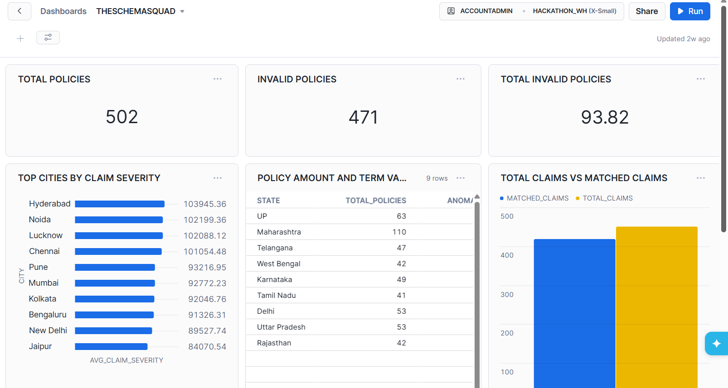
Project Outcome
Successfully processed structured (CSV) and semi-structured (JSON) data.
Built a scalable Snowflake data architecture with multiple layers.
Ensured data security through masking, RBAC, and access policies.
Automated the pipeline using Streams and Tasks.
Generated business-ready datasets for KPI reporting and analytics.

Slide 12
THANK YOU !

